Slide 1
A2E CJA POC -- # 1
Digital Persona Discovery
Please send all correspondences to j.jeng@tcs.com
DSS CONFIDENTIAL

Slide 2
Digital Persona Discovery
Problem Statement: Discover and Describe a Client’s Customers
anticipate customer wants and needs
focus marketing to increase ROI
Approach: Scrape → Match & Enrich → Describe & Characterize
match using k-Nearest-Neighbors
describe using Latent Dirichlet Allocation (i.e. topic modeling)
Scrape
Match
Enrich
Topic Modeling
Analytics

Slide 3
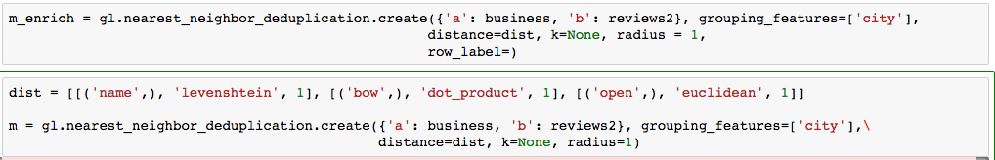
Match and Enrich
Match: pairwise querying and deduplication.

Slide 4
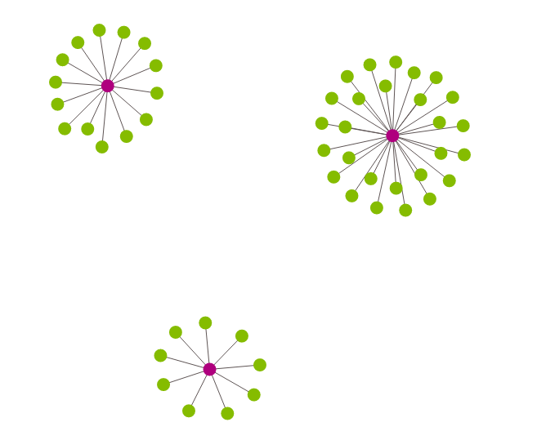
Match and Enrich
Visualize the entities
green nodes are linked records associated with (matched to) each of the pink nodes

Slide 5
Latent Dirichlet Allocation (LDA)
LDA: a method to find latent variables (topics) in a large set of observable variables (words in a corpus). LDA represents documents as mixtures of topics that spit out words with certain probabilities.
topics: viewed as probability distributions of words found “near” each other and the probability of those words to be in a given “topic”
words: assigned probabilities that they appear within a given topic
documents: viewed as probability distributions of topics
by reading the words and comparing to the topic distributions
we can also assign a single topic to each document based on the most represented topic
Notes:
In statistics, latent variables (from Latin: present participle of lateo (“lie hidden”),^{[1]} as opposed to observable variables), are variables that are not directly observed but are rather inferred (through a mathematical model) from other variables that are observed (directly measured)
In Bayesian statistical inference, a prior probability distribution, often simply called the prior, of an uncertain quantity is theprobability distribution that would express one's beliefs about this quantity before some evidence is taken into account. … The unknown quantity may be a parameter of the model or a latent variable rather than an observable variable.
In natural language processing, latent Dirichlet allocation (LDA) is a generative statistical model that allows sets of observations to be explained by unobserved groups that explain why some parts of the data are similar. For example, if observations are words collected into documents, it posits that each document is a mixture of a small number of topics and that each word's creation is attributable to one of the document's topics.

Slide 6
LDA: A very simple example
Consider these 5 “documents”:
I like to eat broccoli and bananas.
I ate a banana and spinach smoothie for breakfast.
Chinchillas and kittens are cute.
My sister adopted a kitten yesterday.
Look at this cute hamster munching on a piece of broccoli.
If asked for 2 topics, LDA might produce:
Sentences 1 and 2: 100% Topic A
Sentences 3 and 4: 100% Topic B
Sentence 5: 60% Topic A, 40% Topic B
Topic A: 30% broccoli, 15% bananas, 10% breakfast, 10% munching, … (at which point, you could interpret topic A to be about food)
Topic B: 20% chinchillas, 20% kittens, 20% cute, 15% hamster, … (at which point, you could interpret topic B to be about cute animals)
Note: in order to do this, LDA assumes prior probability distribution and then iteratively generates topics using a bag-of-words representation

Slide 7
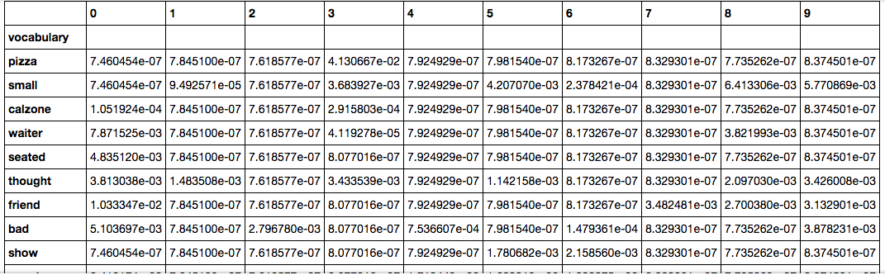
Topics are just probability distributions
Probabilities: of words within topics
this is what it looks like in the Yelp dataset

Slide 8
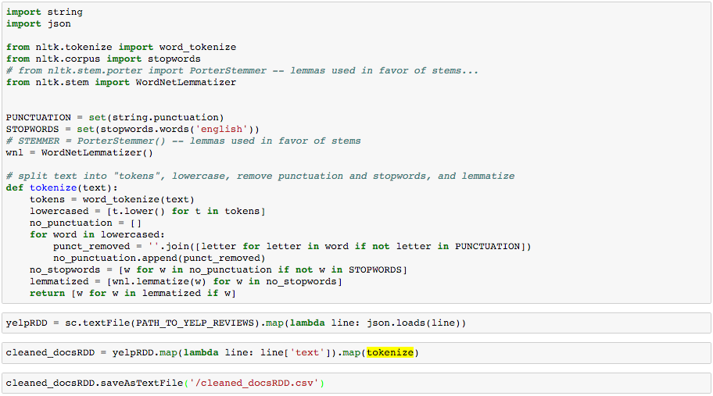
Describing the archetype: loading and cleaning the text

Slide 9
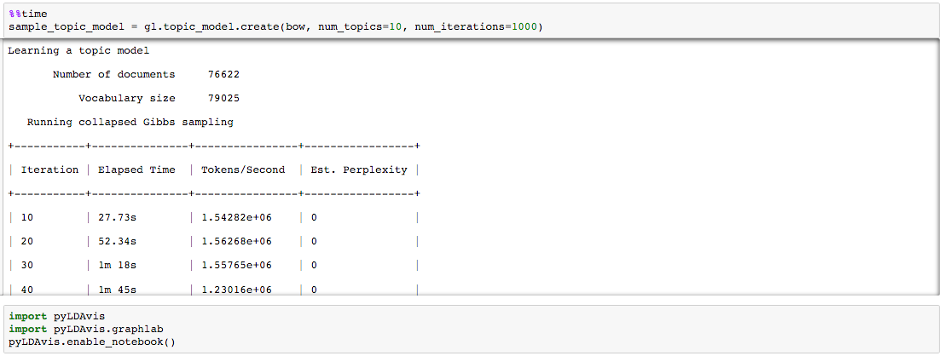
Describing the archetype: finding the topics

Slide 10
Regarding the Persona/Topic Visualizing
Next we visualize the topics
each topic is a probability distribution of individual words
similarity between each topic: Jensen-Shannon divergence
Note: other distance metrics can be passed to the visualization

Slide 11
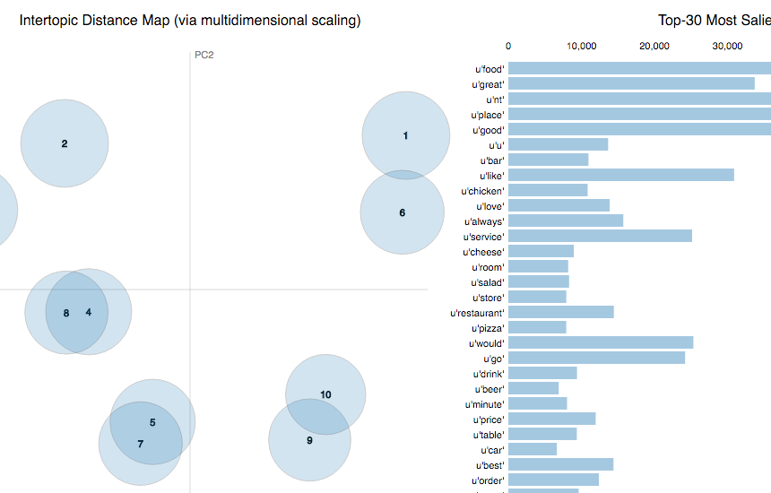
Describing the archetype: interactive visualization of topics

Slide 12
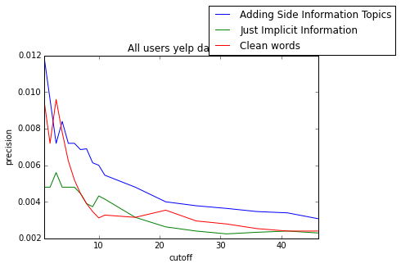
Adding value: connection to recommendation engines
Passing these topics to a recommender we add value!

Slide 13
appendix: inputs outputs

Slide 14
LDA: A very simple example
Consider these 5 “docs”:
Doc 1: I like to eat broccoli and bananas.
Doc 2: I ate a banana and spinach smoothie for breakfast.
Doc 3: Chinchillas and kittens are cute.
Doc 4: My sister adopted a kitten yesterday.
Doc 5: Look at this cute hamster munching on this piece of broccoli.
Note: in order to do this, LDA assumes prior probability distribution and then iteratively generates topics using a bag-of-words representation

Slide 15
LDA: A very simple example
Bag of words representation:
Doc 1: {I: 1, like: 1, to: 1, eat: 1, broccoli: 1, and: 1, bananas: 1}
Doc 2: {I: 1, ate: 1, a: 1, banana: 1, and: 1, spinach: 1, smoothie: 1, for: 1, breakfast: 1}
Doc 3: {Chinchillas: 1, and: 1, kittens: 1, are: 1, cute: 1}
Doc 4: {My: 1, sister: 1, adopted: 1, a: 1, kitten: 1, yesterday: 1}
Doc 5: {Look: 1, at: 1, this: 2, cute: 1, hamster: 1, munching: 1, on: 1, piece: 1, of: 1, broccoli: 1}
Note: in order to do this, LDA assumes prior probability distribution and then iteratively generates topics using a bag-of-words representation

Slide 16
LDA: A very simple example
If asked for 2 topics, LDA might (remember, estimation via prior distribution) produce:
Doc 1 and 2: 100% Topic A
Doc 3 and 4: 100% Topic B
Doc 5: 60% Topic A, 40% Topic B
Topic A: 30% broccoli, 15% bananas, 10% breakfast, 10% munching, … (at which point, you could interpret topic A to be about FOOD)
Topic B: 20% chinchillas, 20% kittens, 20% cute, 15% hamster, … (at which point, you could interpret topic B to be about CUTE ANIMALS)
Note: in order to do this, LDA assumes prior probability distribution and then iteratively generates topics using a bag-of-words representation

